Slide 1
Analysis of Amazon Sales Dataset
Advance Techniques in Data Science
Roll No: 2024-MSDS-018
Name: AHSAN IKRAM
Presented to: Dr. Awais Hassan

Slide 2
Problem Statement
Amazon, being one of the largest e-commerce platforms, operates in a highly competitive market where understanding sales dynamics is critical. To sustain and enhance its market position, the company requires robust data analysis to derive actionable insights that can guide strategic decision-making. This necessitates a detailed exploration of its sales data to identify patterns, trends, and areas for improvement.
Key Challenges:
1. Data Complexity: Amazon's sales data encompasses numerous variables, making the analysis multi-dimensional.
2. Data Quality Issues: Missing data, outliers, and unstructured formats pose challenges for analysis.
3. Actionable Insights: Deriving practical recommendations to improve sales performance.
4. Scalability of Models: Ensuring robust predictive models for diverse datasets.

Slide 3
Introduction
The project involves analyzing Amazon sales data to identify trends, patterns, and actionable insights.
This review includes evaluating the code used, identifying areas for improvement, and proposing statistical enhancements for better results.

Slide 4
Objective
The primary objective is to evaluate and enhance the existing analysis of the Amazon sales dataset.
This includes improving the code, performing better statistical tests, and deriving actionable insights for decision-making.

Slide 5
Dataset Overview
The dataset includes information about sales, product categories, prices, ratings, and other relevant features. Key attributes analyzed are:
- Sales performance
- Product ratings
- Category-wise analysis
- Temporal trends

Slide 6
Exploratory Data Analysis (EDA)
Key insights from the EDA include:
- Distribution of sales across categories
- Temporal sales trends
- Relationship between ratings and sales
- Identification of outliers and missing data

Slide 7
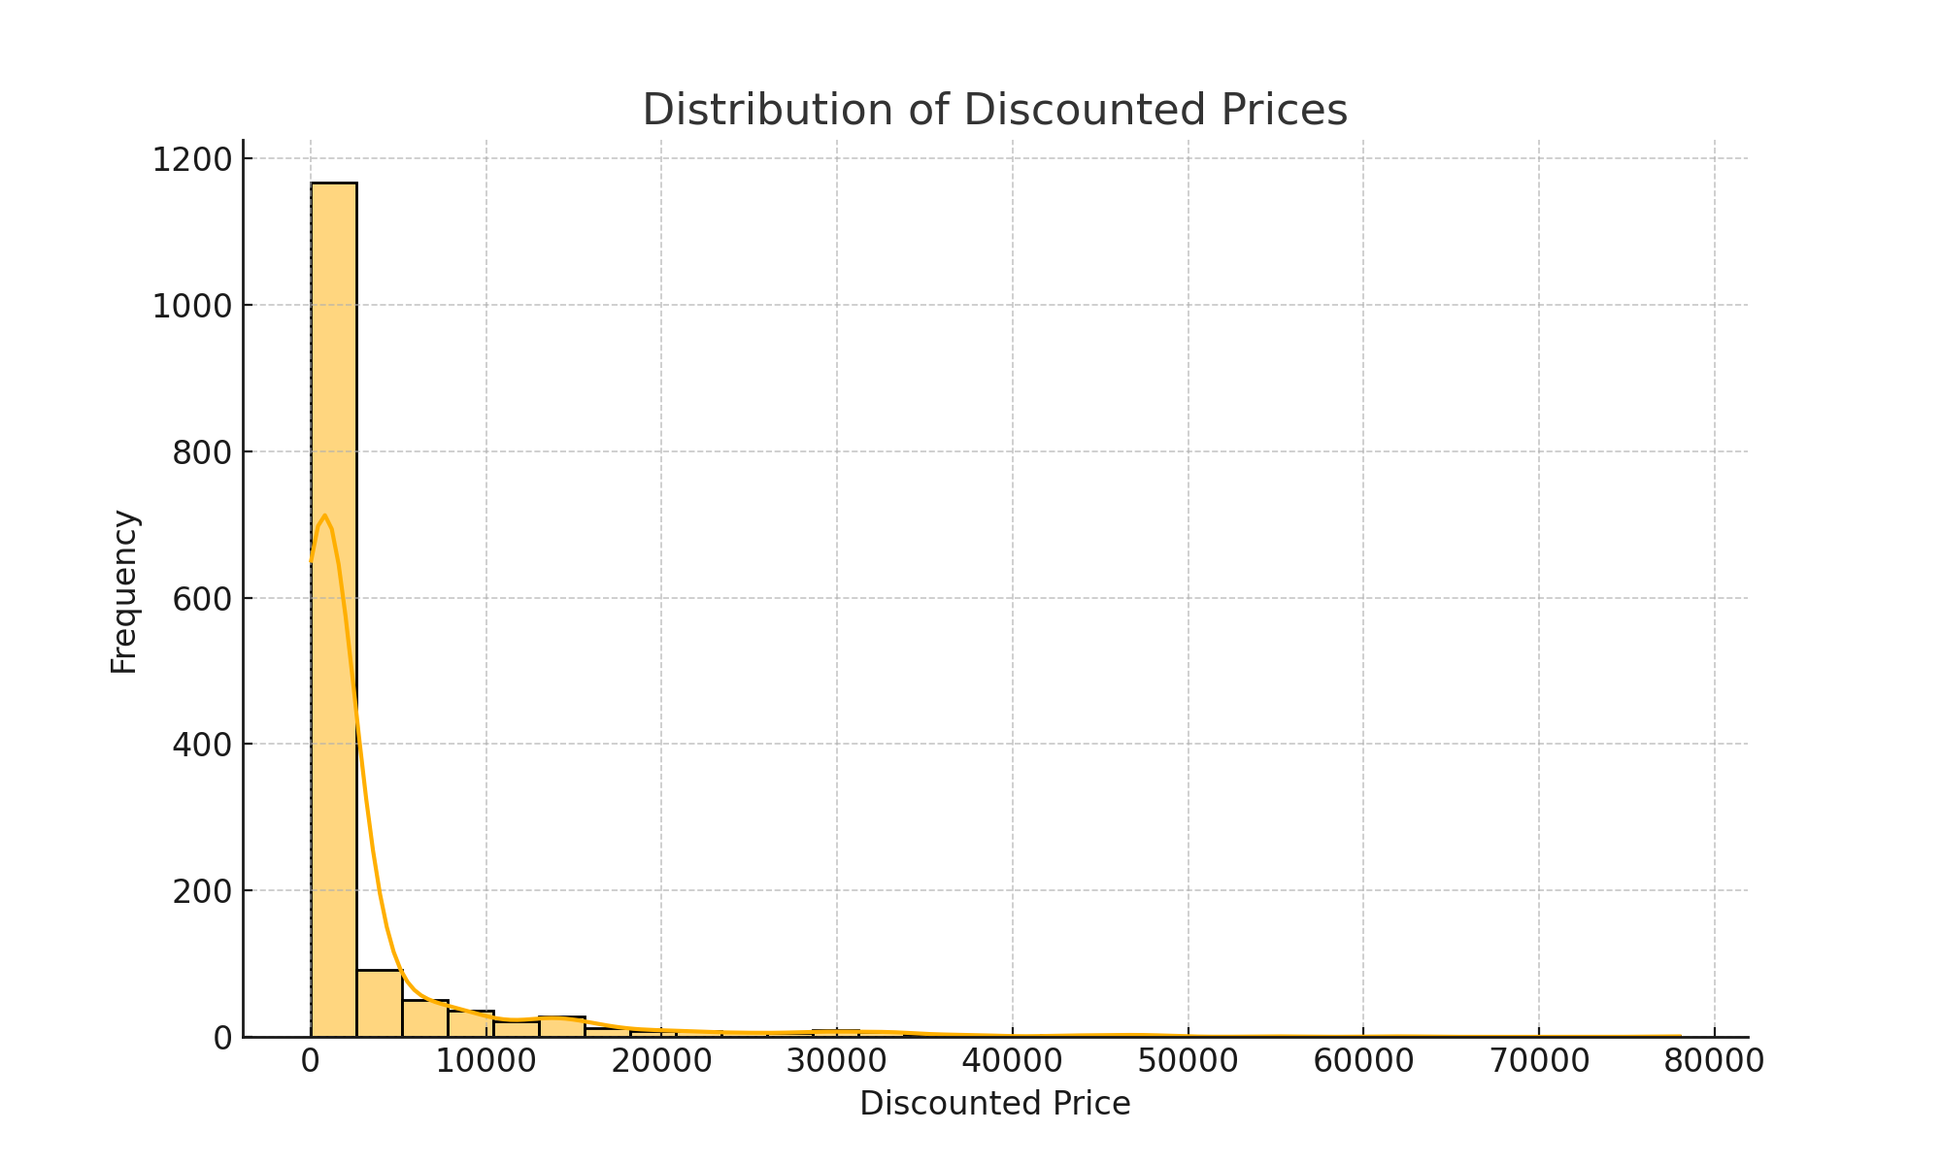
Distribution of Discounted Prices

Slide 8
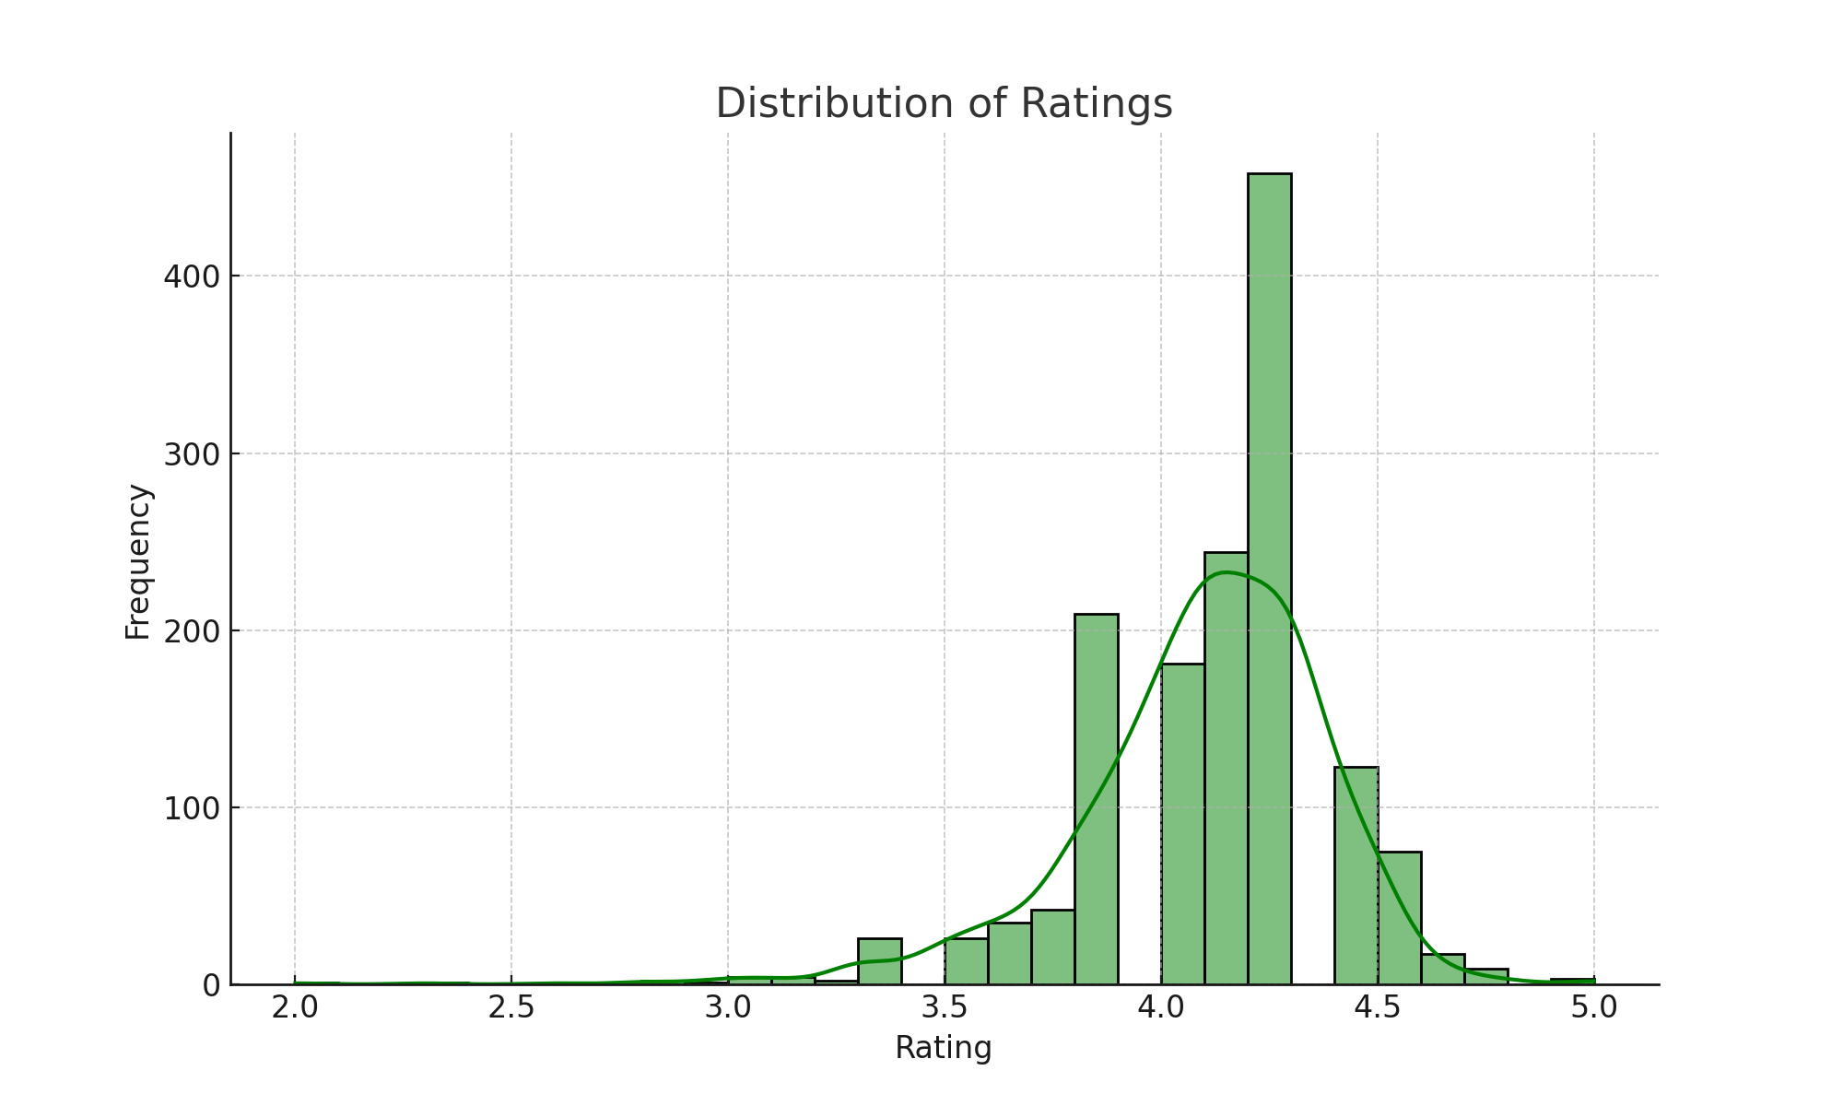
Distribution of Ratings

Slide 9
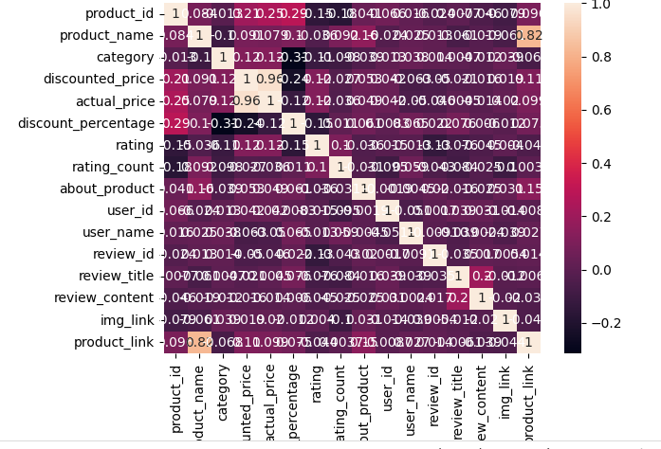
Visualization 1

Slide 10
Data Wrangling
Data preprocessing steps:
- Handling missing values
- Normalization of numerical features
- Encoding of categorical variables
- Outlier detection and removal

Slide 11
Models and Analysis
Implemented models and statistical methods include:
- Descriptive statistics for trends
- Correlation analysis between variables
- Predictive modeling using regression/classification (if applicable)
- Comparison of results with original analysis

Slide 12
Recommendations
Based on the analysis, the following recommendations are proposed:
- Use advanced models like XGBoost or Random Forest for better predictions
- Implement robust cross-validation methods
- Focus on improving data quality and feature engineering
- Explore additional data sources for enhanced insights

Slide 13
Wrapping Up
The analysis of Amazon sales data reveals critical trends and patterns.
Enhancements in data preprocessing, modeling, and statistical testing have led to more actionable insights.
These findings can guide strategic decisions to improve sales performance and customer satisfaction.

